Slide 1

CERVICAL CANCER DETECTION
NIE FIRST GRADE COLLEGE
To :
Anjali. R
Lecturer
Dept Of Computer Science
By:
Subramanya M S
Apoorva Kumar V R

Slide 2
CONTENTS
Introduction
Literature Survey
System Analysis and Design
User Interface (UI) Design
System Implementation
Conclusion
Future Enhancement
Reference

Slide 3
INTRODUCTION

Slide 4
80% of the new cervical cancer cases occur in developing countries like India.
The proposed system will reduce the workload on clinicians and makes the diagnosis of cancer faster, economical.
It is more accurate by making use of image processing techniques of MATLAB.

Slide 5
CAUSES FOR CERVICAL CANCER
Oral contraceptives : Long-term use of oral contraceptives is associated with increased risk of cervical cancer.
Smoking : Among HPV-infected women, current and former smokers have roughly two to three times the incidence of invasive cancer.
Multiple pregnancies : Having many pregnancies is associated with an increased risk of cervical cancer

Slide 6
OBJECTIVE
To develop an automated system that enable proficient and effective detection of Cervical Cancer.
That can be implemented for commercial purpose. Making use of image processing toolboxes of MATLAB.
Pathologists can use this method as a decision support in detecting cancer.
This will reduce the workload on clinicians and makes the diagnosis of cancer faster.

Slide 7
ADVANTAGES
Ease of use
Generic
Flexible

Slide 8
LITERATURE SURVEY

Slide 9
Eko Supriyanto developed a detection system that is able to differentiate between normal and cancerous cells
N Sakthi Priya discussed cervical cancer screening and classification using acoustic shadowing
G Karthigai Lakshmi and K Krishnaveni discussed multiple feature extraction from Cervical cytology image by Gaussian mixture model.
Shipra Roy, R.P Chauhan, G.K. Verman done a study towards developing an automatic image classification system by classifying Region of Interest (ROI).

Slide 10
SYSTEM ANALYSIS

Slide 11
REQUIREMENT SPECIFICATION
Software Requirements:
Tool : MATLAB
Coding Language : MATLAB Code in C++
Operating System : Windows 7 (higher version)
Hardware Requirements:
Processor : I3
Hard disk : 100 GB
RAM : 2 GB Above

Slide 12
EXISTING SYSTEM
Liquid-based cytology (LBC) test : The LBC test is a cervical screening test that is done to identify any abnormal changes in the cells of the cervix.
HPV(Human papilloma virus) DNA test : HPV test can find any of the high-risk types of HPV that are most commonly found in cervical cancer.

Slide 13
PROPOSED SYSTEM
The system can detect cervical cancer using image processing techniques.
MATLAB image processing toolbox is used to extract features from cytology images.
The dominant features used for diagnosis are Nucleus to cytoplasm ratio, shape, and colour intensity along with nucleus area, perimeter and eccentricity .
The cytology cells were then successfully classified as non-cancerous, low- grade and high-grade cancer cells.

Slide 14
FUNCTIONAL REQUIREMENTS
Pathologist: Pathologist are the end users who uses the application to get their results consist of the image which shows whether the one is suffering from the cancer or not.
The proposed system should be able to diagnose and display the image in the BW colour space
It is helpful to detect the affected cells in the sample supplied

Slide 15
DATA COLLECTION
It is the database of single pap-smear cells pictures.
Each cell image is manually classified into the 7 different types of cells.
If the validation is negative the image is discarded.

Slide 16
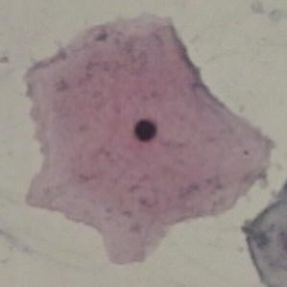
The distribution of the data set are as follows.
NORMAL CELLS :
SUPERFICIAL SQUAMOUS CELL
CELL SIZE : Large
CELL SHAPE : Flat / Oval
NUCLEUS : Very small
CYTOPLASM : Bright , Sharply demarcated ,Stains Red
16

Slide 17
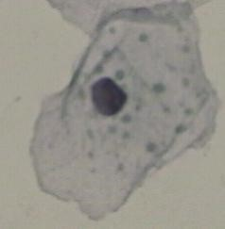
INTERMEDIATE SQUAMOUS CELL
CELL SIZE : Large
CELL SHAPE : Round
NUCLEUS : Large
CYTOPLASM : Light blue/Blue-Green

Slide 18
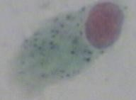
COLUMNAR EPITHELIAL CELLS
CELL SIZE : Large
CELL SHAPE : Column Like
NUCLEUS : Large
CYTOPLASM : Distributed Chromatin, Stain more Dark Blue

Slide 19
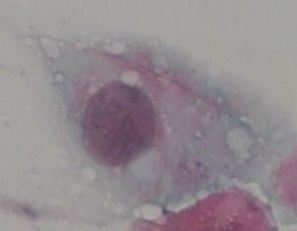
ABNORMAL CELLS :
MILD DYSPLASIA
CELL SIZE : Very Large
NUCLEUS : Large/Light
CYTOPLASM : Light, Generous and See-through
N/C RATIO : Medium

Slide 20
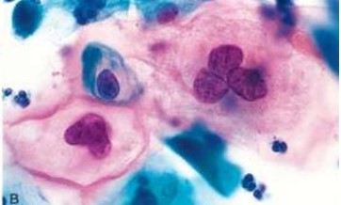
MORDARATE DYSPLASIA
CELL SIZE : Very Large
NUCLEUS : Large/Dark
CYTOPLASM :Dark
N/C RATIO : Large

Slide 21
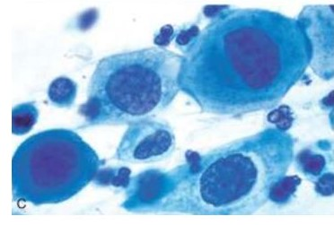
SERVER DYSPLASIA
CELL SIZE : Very Large
NUCLEUS : Large/Dark/Deform
CYTOPLASM :Dark
N/C RATIO : Very Large

Slide 22

CARCINOMA IN SITU
CELL SIZE : Large
CYTOPLASM : Sparse and Basophilic
NUCLEUS : about 3-5 times large than normal nuclei
N/C RATIO : Very Large

Slide 23
NON-FUNCTIONAL REQUIREMENTS
Availability
Maintainability
Reliability
Scalability
End user requirements

Slide 24
DESIGN AND ANALYSIS

Slide 25
SYSTEM ARCHITECTURE
INPUT
GRAY SCALE
CONVERSION
GAUSSIAN
FILTER
GROUPING AFFECTED CELLS
BRIDGE AND HOLE FILLING
CANNY EDGE DETECTION
DETECTION OF CANCER CELLS

Slide 26
METHODOLOGY
GREY-SCALE CONVESRION
The biological RGB cell image (bitmap image) is converted into grey-scale image.
In this step 3D image is converted into 2D image.
A pre-processing technique is applied to grey-scale image to improve the quality of image.

Slide 27
GAUSSIAN FILTER
In image processing, a Gaussian Filter is the result of blurring an image by a Gaussian Function.
Gaussian filters are generally isotropic.
Gaussian Filter basically applied to reduce image noise and to eliminate the useless information in image.
An image can be filtered by an isotropic Gaussian filter by specifying a scalar value for sigma.

Slide 28
GROUPING AFFECTED CELLS
Adaptive thresholding is an image segmentation algorithm that appears quite resistant to varying lighting conditions.
The most basic thresholding method is to choose a fixed threshold value and compare each pixel to that value
The maximum intensity values of smoothen image is considered as background.

Slide 29
CANNY EDGE DETECTION
Canny Edge function is used find edges in intensity image.
This function looks for places in the image where the intensity changes rapidly
The Canny edge technique is used to extract the abrupt changes of affected cells and non- affected cells.
This technique helps us to make the difference between affected and non affected cells.

Slide 30
EXTRACTION OF HOLES AND AFFECTED CELLS
Where, affected cells form large sized holes and non-affected cells form small sized holes.
Some of the cells could not generate the holes, at that time bridge morphological function is used to generate the holes.
The larger components are considered as affected cells.
To retain this larger components, the morphological functions are used effectively

Slide 31
JACCARD SIMILARITY COEFFICIENT
It is defined as the quotient between the intersection and the union of the pair wise compared variables among two objects.
It Determining the Quality by compraing values of Cytological cell image with its Ground truth image.

Slide 32
USER INTERFACE (UI) DESIGN

Slide 33
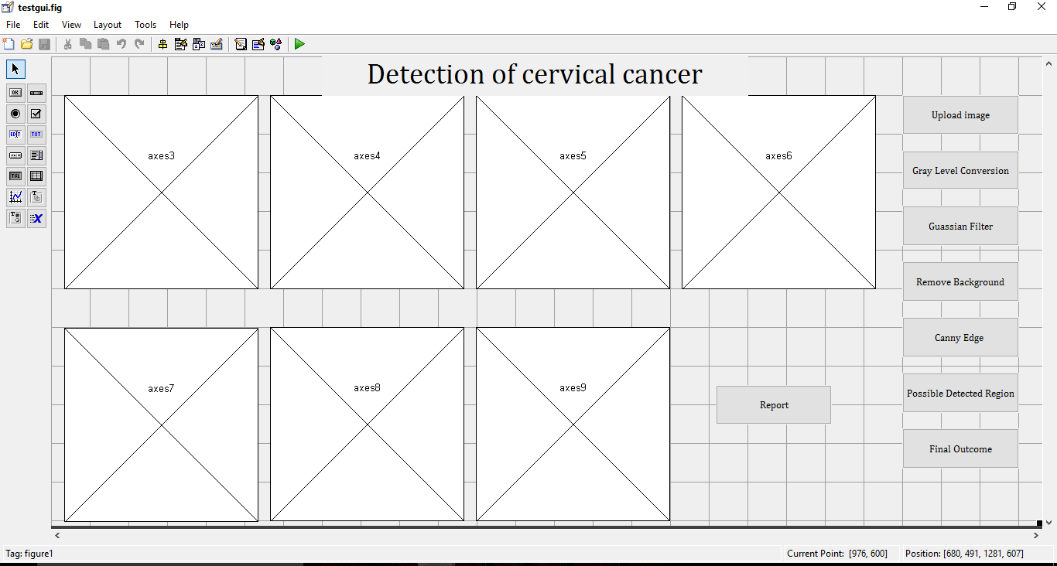
AXES
STATIC TEXT
PUSH BUTTON
GUI OF THE DETECTION OF CERVICAL CANCER

Slide 34
AXES : Axes are the display section of the report from the processed image obtained from the image that was provided as an input..
STATIC TEXT: Static text is the header of the analysis and gives the title of the analysis being provided by the axes.
PUSH BUTTON: Push button is the interactive components of the GUI. The operations to be performed using the GUI is accomplished using the Push Buttons

Slide 35
IMPLEMENTATION

Slide 36
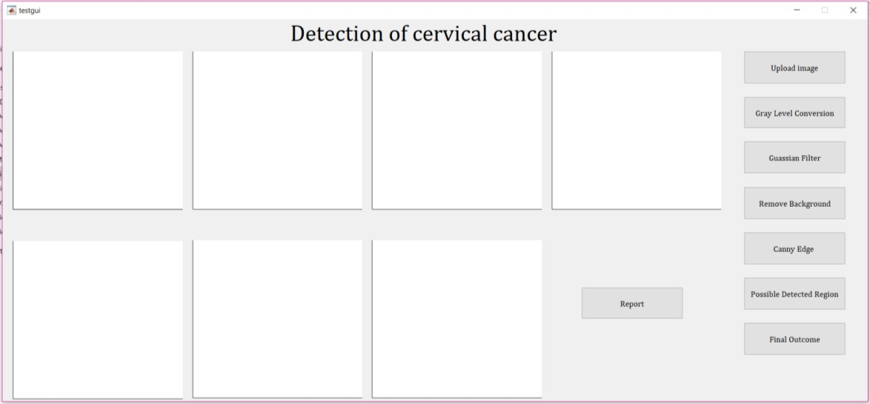
USER INTERFACE

Slide 37
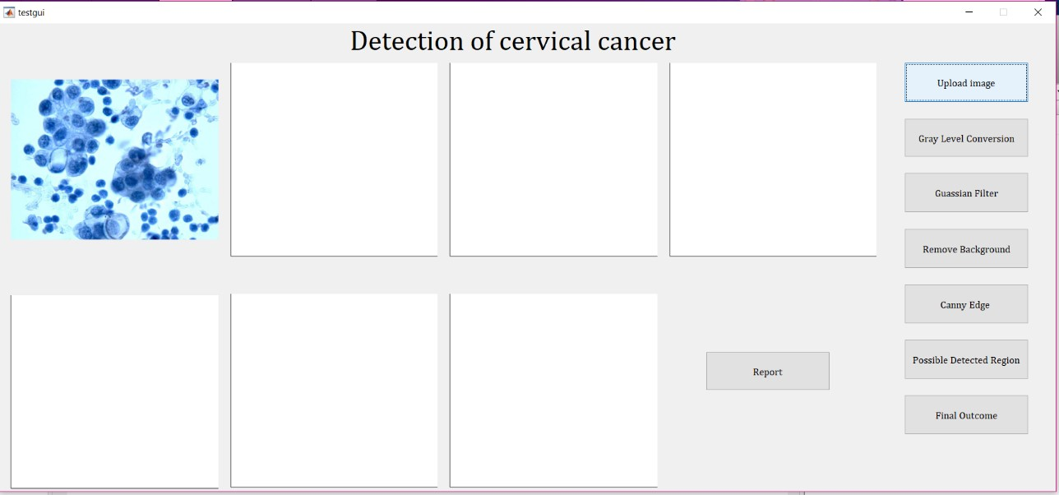
UPLOADING AN IMAGE

Slide 38
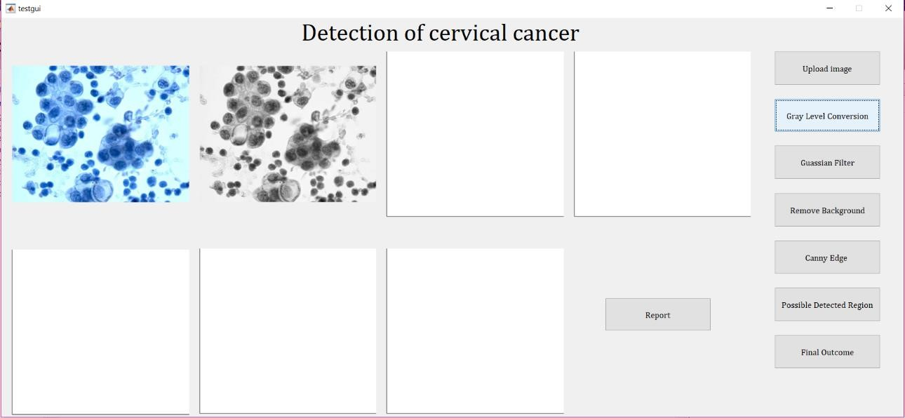
GREYSCALE CONVERSION

Slide 39
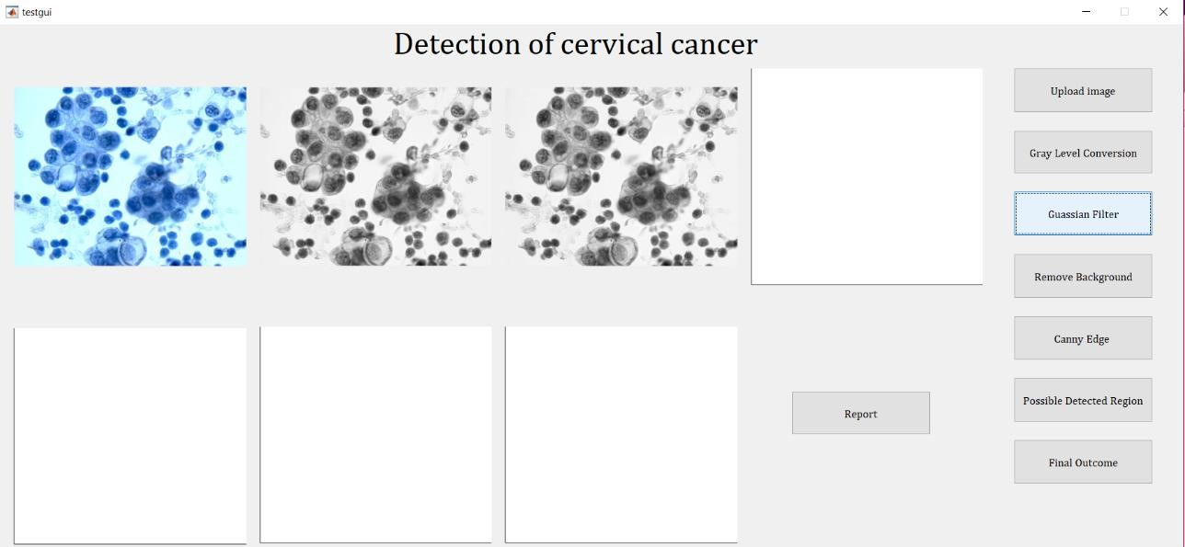
GAUSSAIN FILTER

Slide 40
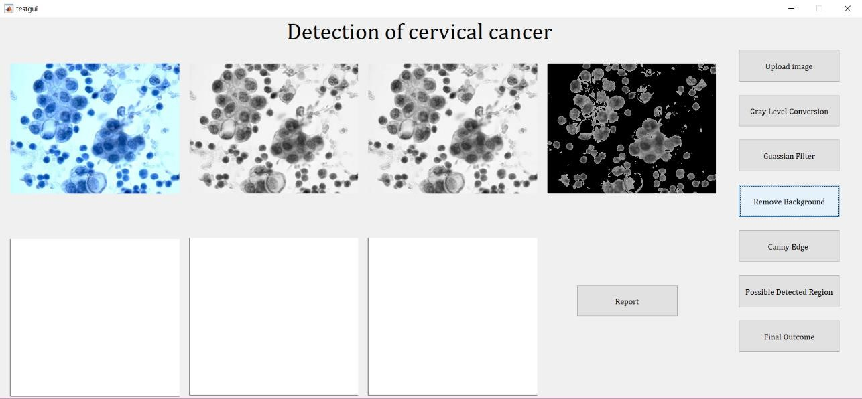
GROUPING AFFECTED CELLS

Slide 41
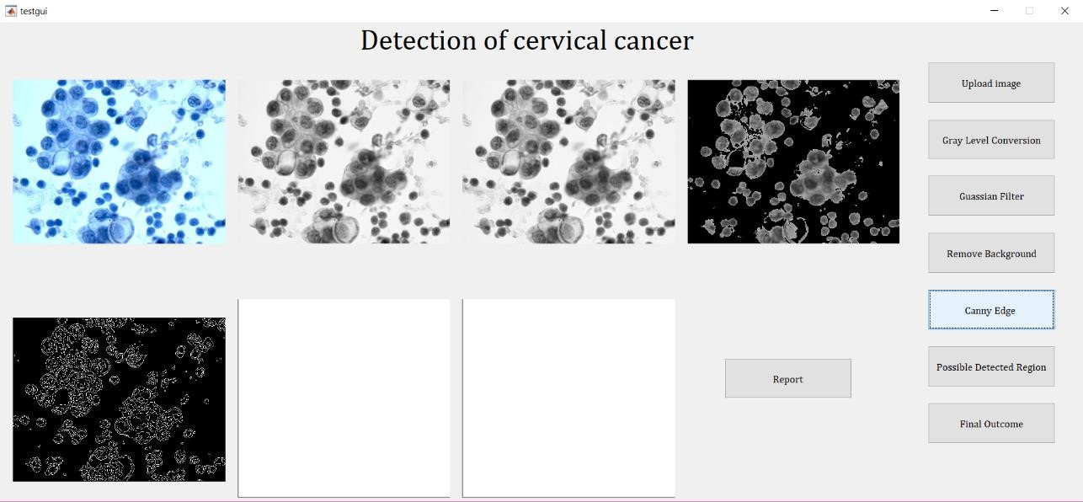
CANNY EDGE TECHNIQUE

Slide 42
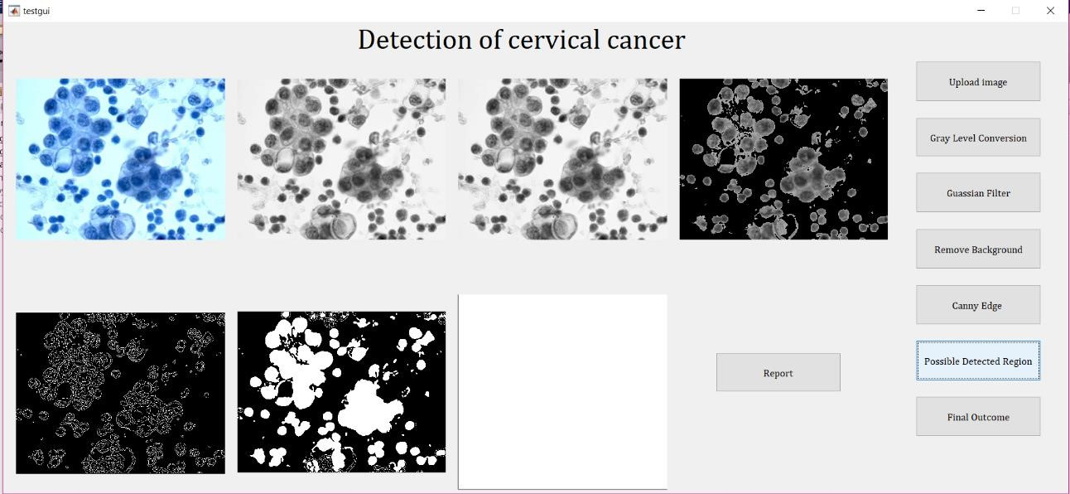
EXTRACTION OF HOLES

Slide 43
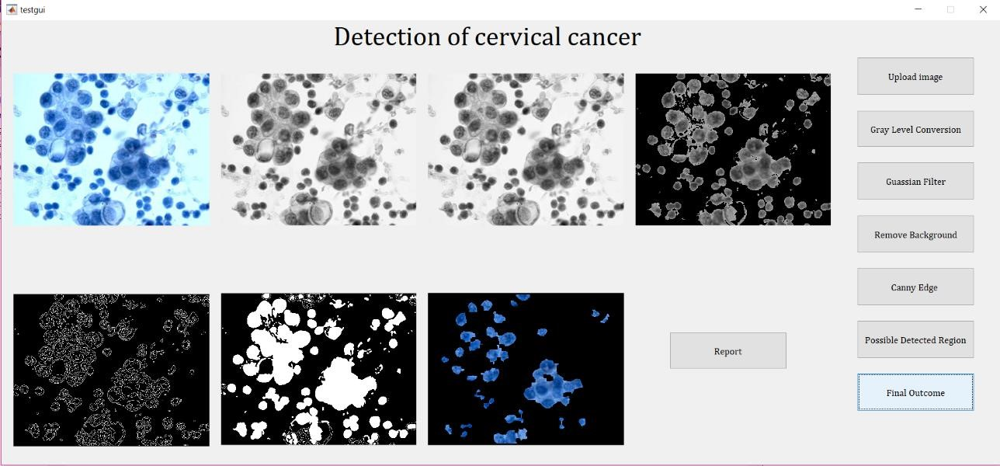
EXTRACTION OF AFFECTED CELLS

Slide 44
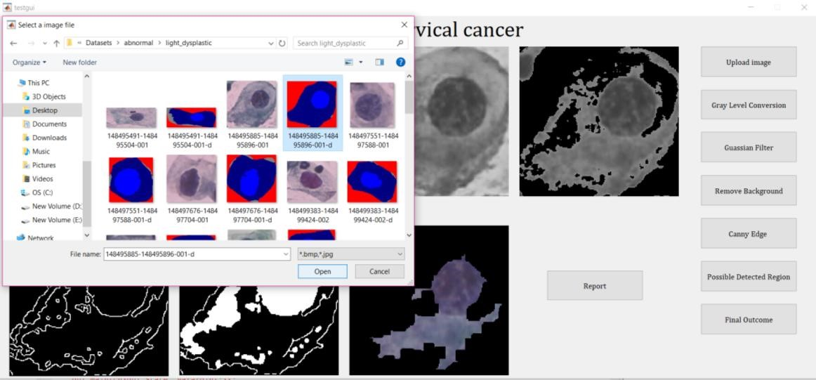
DETECTING ACCURACY BY USING GROUND TRUTH IMAGE FOR CERVICAL CELL

Slide 45
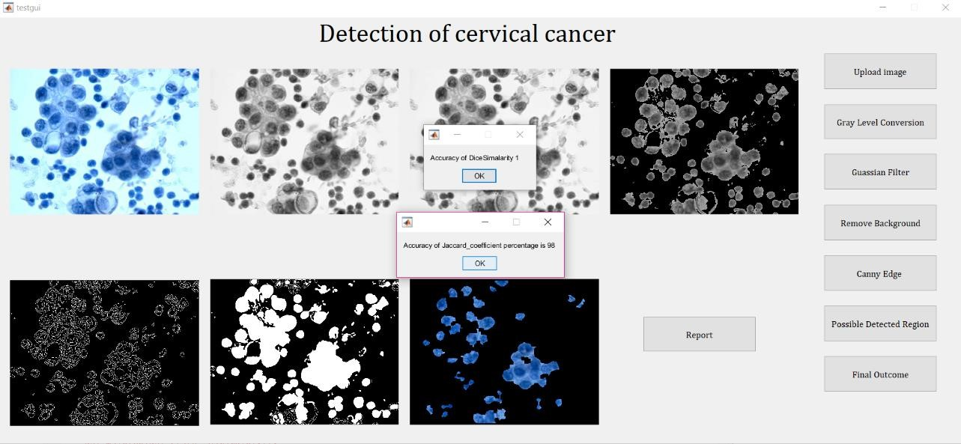
ACCURACY DISPLAYING IN PERCENTAGE

Slide 46
FUTURE ENHANCEMENT:
In future this system can provide other Cancer like Blood Cancer , Lung Cancer.
Our future work includes classifying the cancerous cells further as low grade and high grade cells.
This system is designed for Cervical Cancer detection to provide accurate stage of cancer.

Slide 47
CONCLUSION:
The manually screened technique suffers from high fake price due to human errors.
A method is achieved for the automated detection of cervical cancer using image processing techniques .
Automated techniques are done to supply correct outcomes and to make powerful classification of normal and abnormal cells.

Slide 48
THANK YOU

